Slide 1

Team…. Thailand4.0

Slide 2



Introduction
Weeya Weerawatpruchya
Weeya Weerawatpruchya
Weeya Weerawatpruchya

Slide 3

Agenda
Our expectation
FI Upstream SAP
Pain point & Solution
Work process
Intern life

Slide 4

Expectation
Working
experience
Technical
skills
Hard & soft skill
Find myself
New friends

Slide 5



Financial Upstream SAP
Support
EMIT FI Upstream SAP
Upstream business
Notes:
Which each team responsible for support FI Upstream(non-EMIT) in different region. And we're in Thotsakan team.

Slide 6


Financial Upstream SAP
Scrumblers
Polaris
Supernova
Thotsakan
4 teams
Notes:
EMIT FI Upstream team separate to 4 teams, Thotsakan, Scrumblers, Supernova and Polaris.

Slide 7










Thotsakan
Scrumblers
Supernova
Polaris
IT Console
Users
Dispatcher
Notes:
(Animation) Users report problem/issue as a ticket and we have ticket dispatcher to monitor tickets and assign that ticket to team member for solving problem

Slide 8
Why tickets are important?
Notes:
Critical to business ---- example

Slide 9
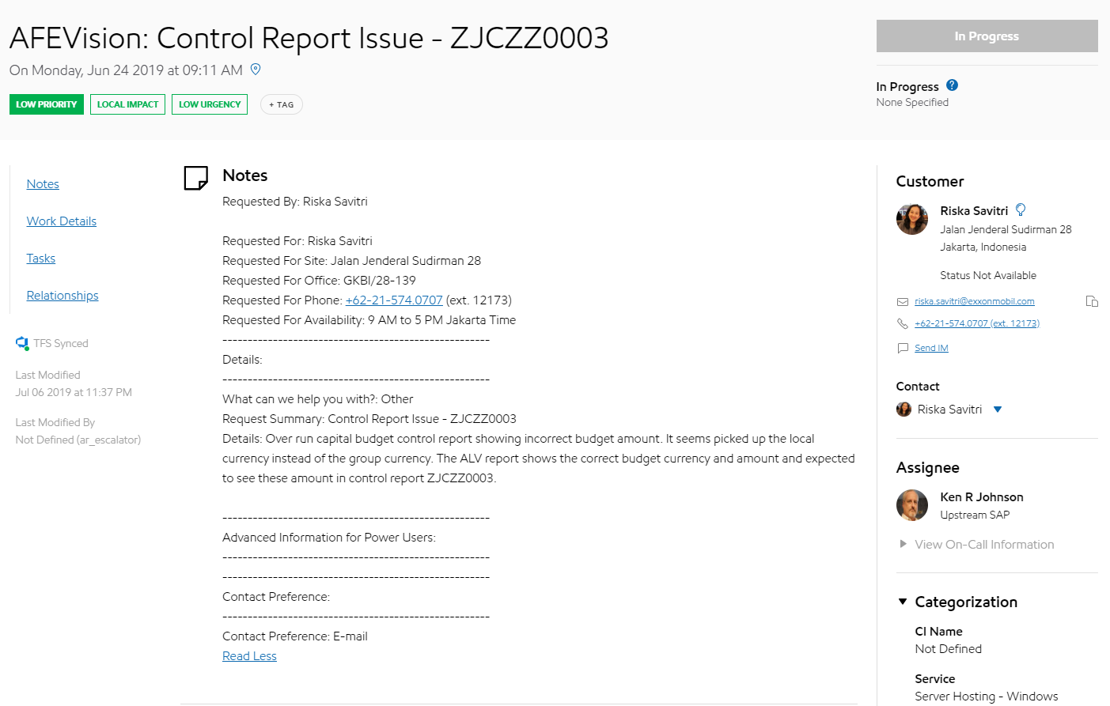
Ticket
Summary
Customer
Details
Notes:
Let’s take a look at real ticket
In the ticket will have summary of tickets (title), detail that customer write to explain more about their problem, customer who open the ticket

Slide 10
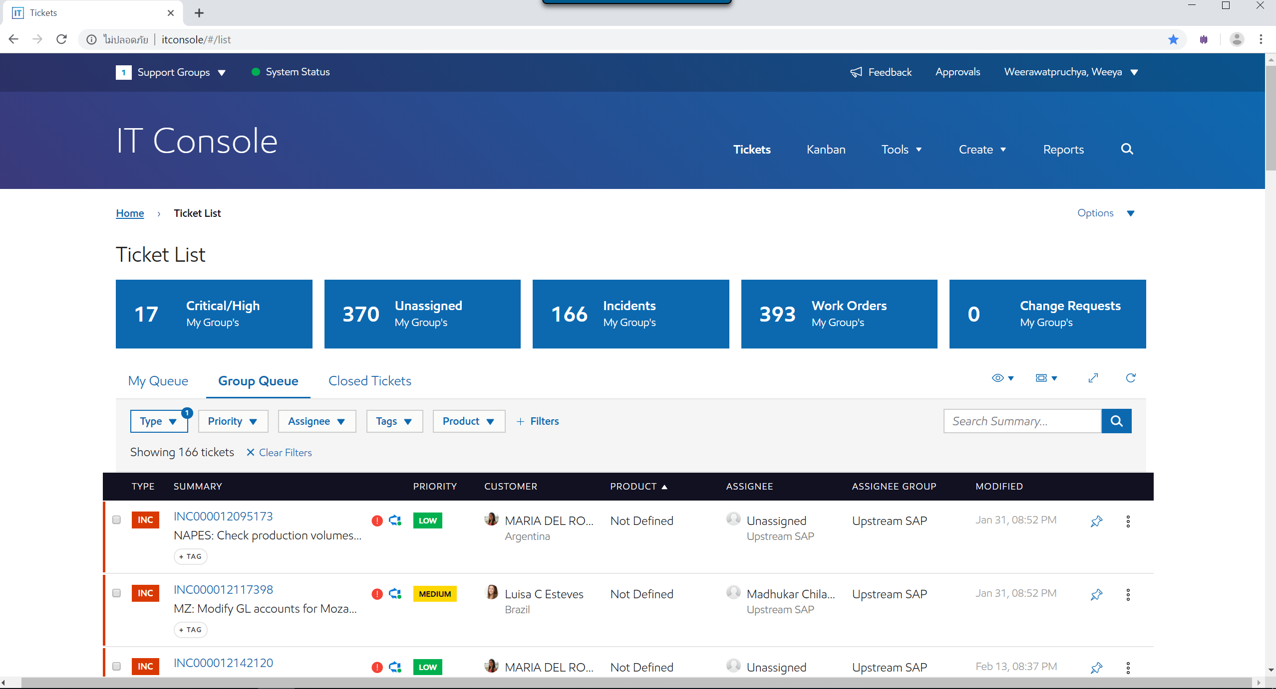

IT Console
Users
Notes:
We have tickets and we have IT console the website for display all tickets from users
And this is the real IT console as you can see display all tickets here… and have a filter
But IT console not suitable for our team structure that have 4 sub team ….. All tickets from 4 team in the same page

Slide 11




Classify & Assign tickets
?
FI Upstream SAP
4 sub-teams
?
Thotsakan
Scrumblers
Supernova
Polaris
Notes:
Let’s see how our team classify & assign ticket
We have 4 dispatcher & hundred of tickets

Slide 12
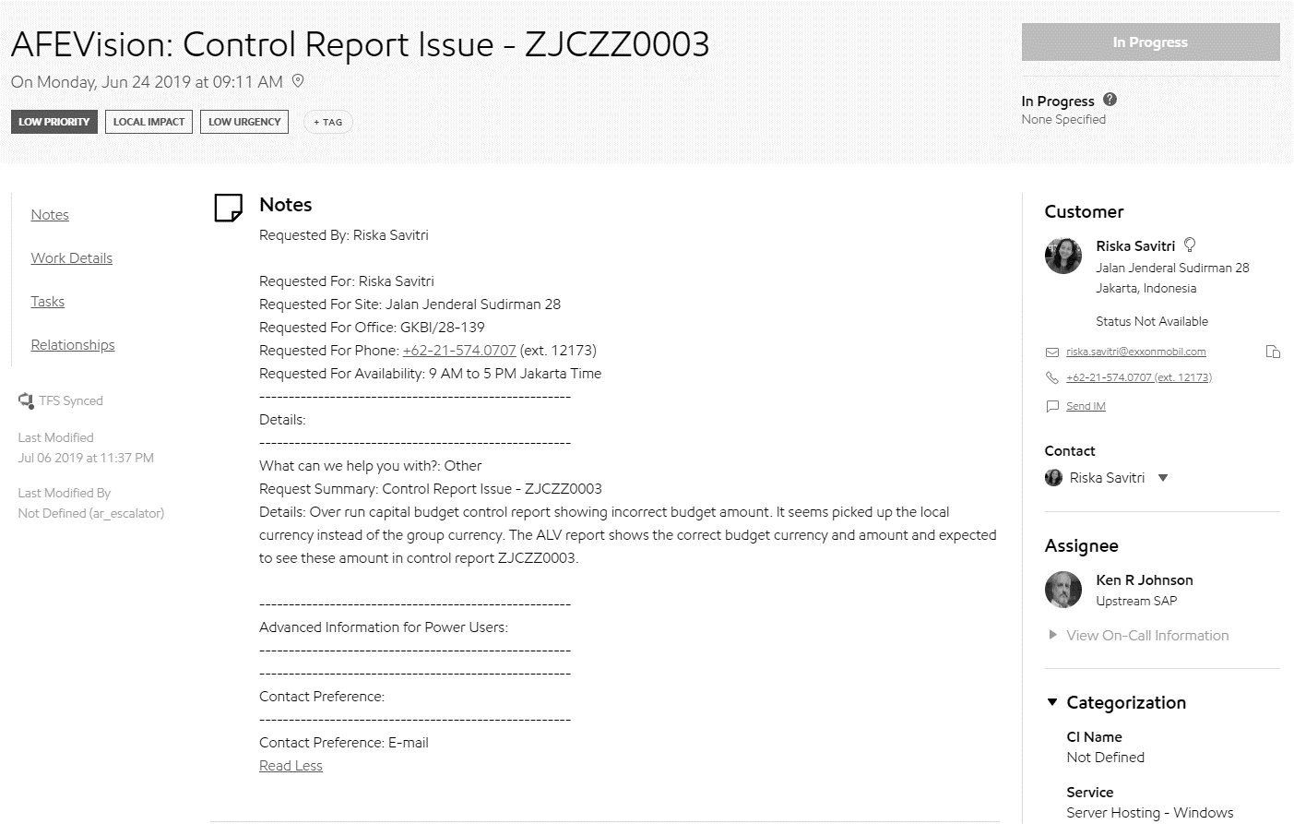
Classify & Assign tickets
3. Customer region?
2. Keyword?
IPES & NAPES?
NAPES?
Company code → Impact country
Impact country?
Pain point
1. Assign?
DIspatcher
Notes:
This is a ticket…
To classify team first dispatcher have to look at assignee is it assign or not? If already assign so we know where ticket belong to
If not look at next point in the note have any keyword like IPES & NAPES if not NAPES? → scrumblers If not we look for company code and we have to mapping company code to impact country and for mapping we have to use other file for reference. And when we got impact country if impact country is in AP → thotsakan if not lets look at customer region…. If some of you have a question why customer won’t tell definitely which team should responsible for that problem
Because customer also don’t know too. They just monitor and report problem.
As you can see from this step it take too much time to classify and that the pain point of dispatcher!!!!!

Slide 13


Solution
Ticket
Thotsakan
Scrumblers
Classification system
Supernova
Polaris

Slide 14




Work process
Agile
methodology
Scrum
framework

Slide 15
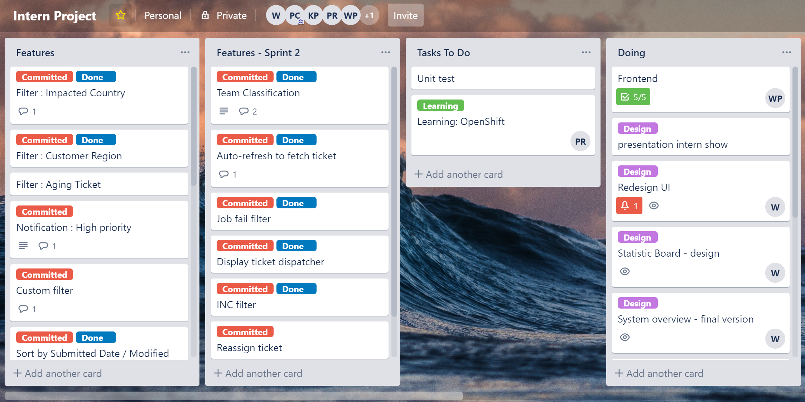

Slide 16
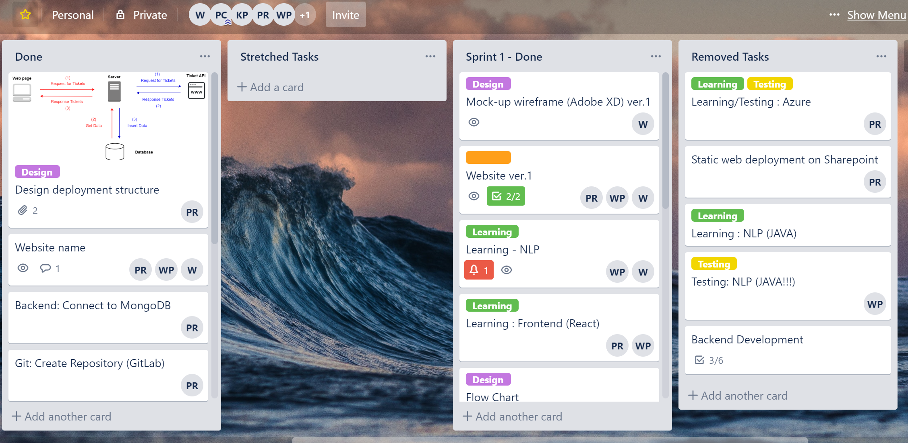

Slide 17
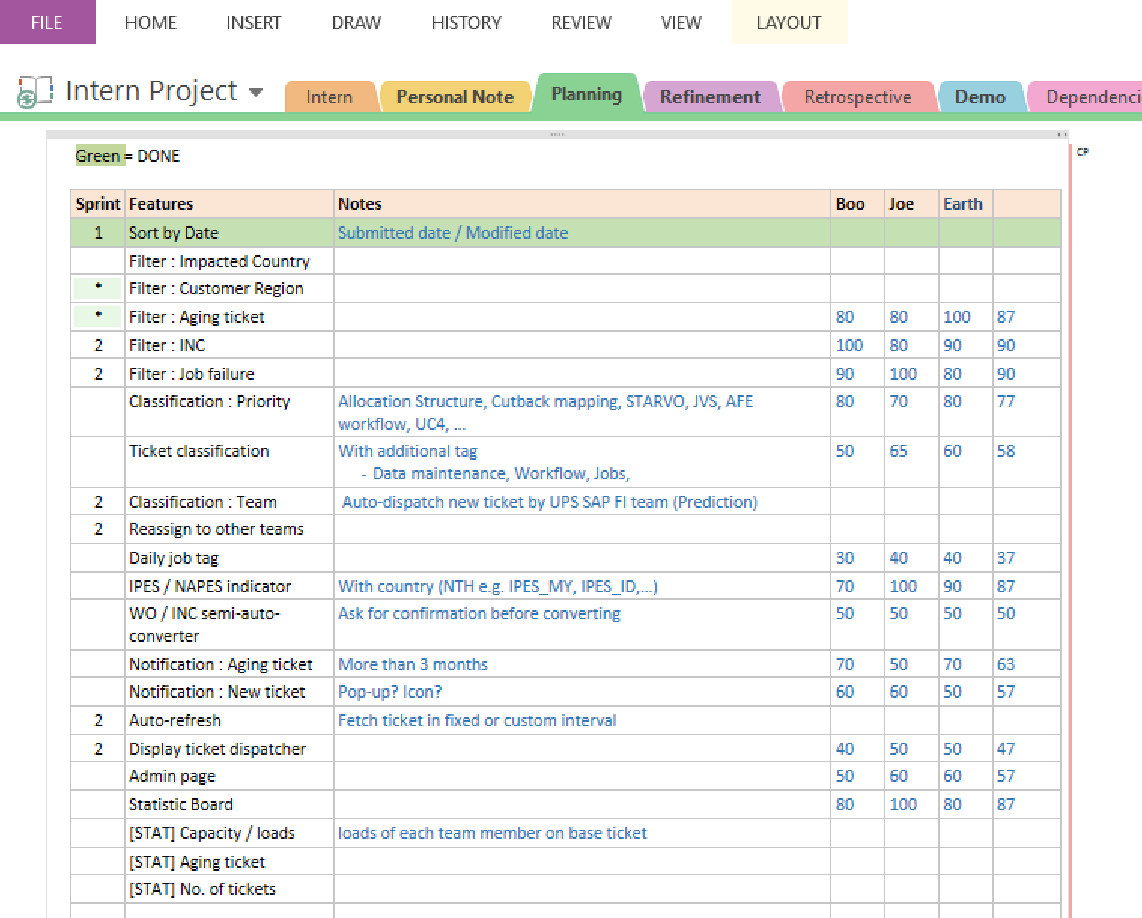
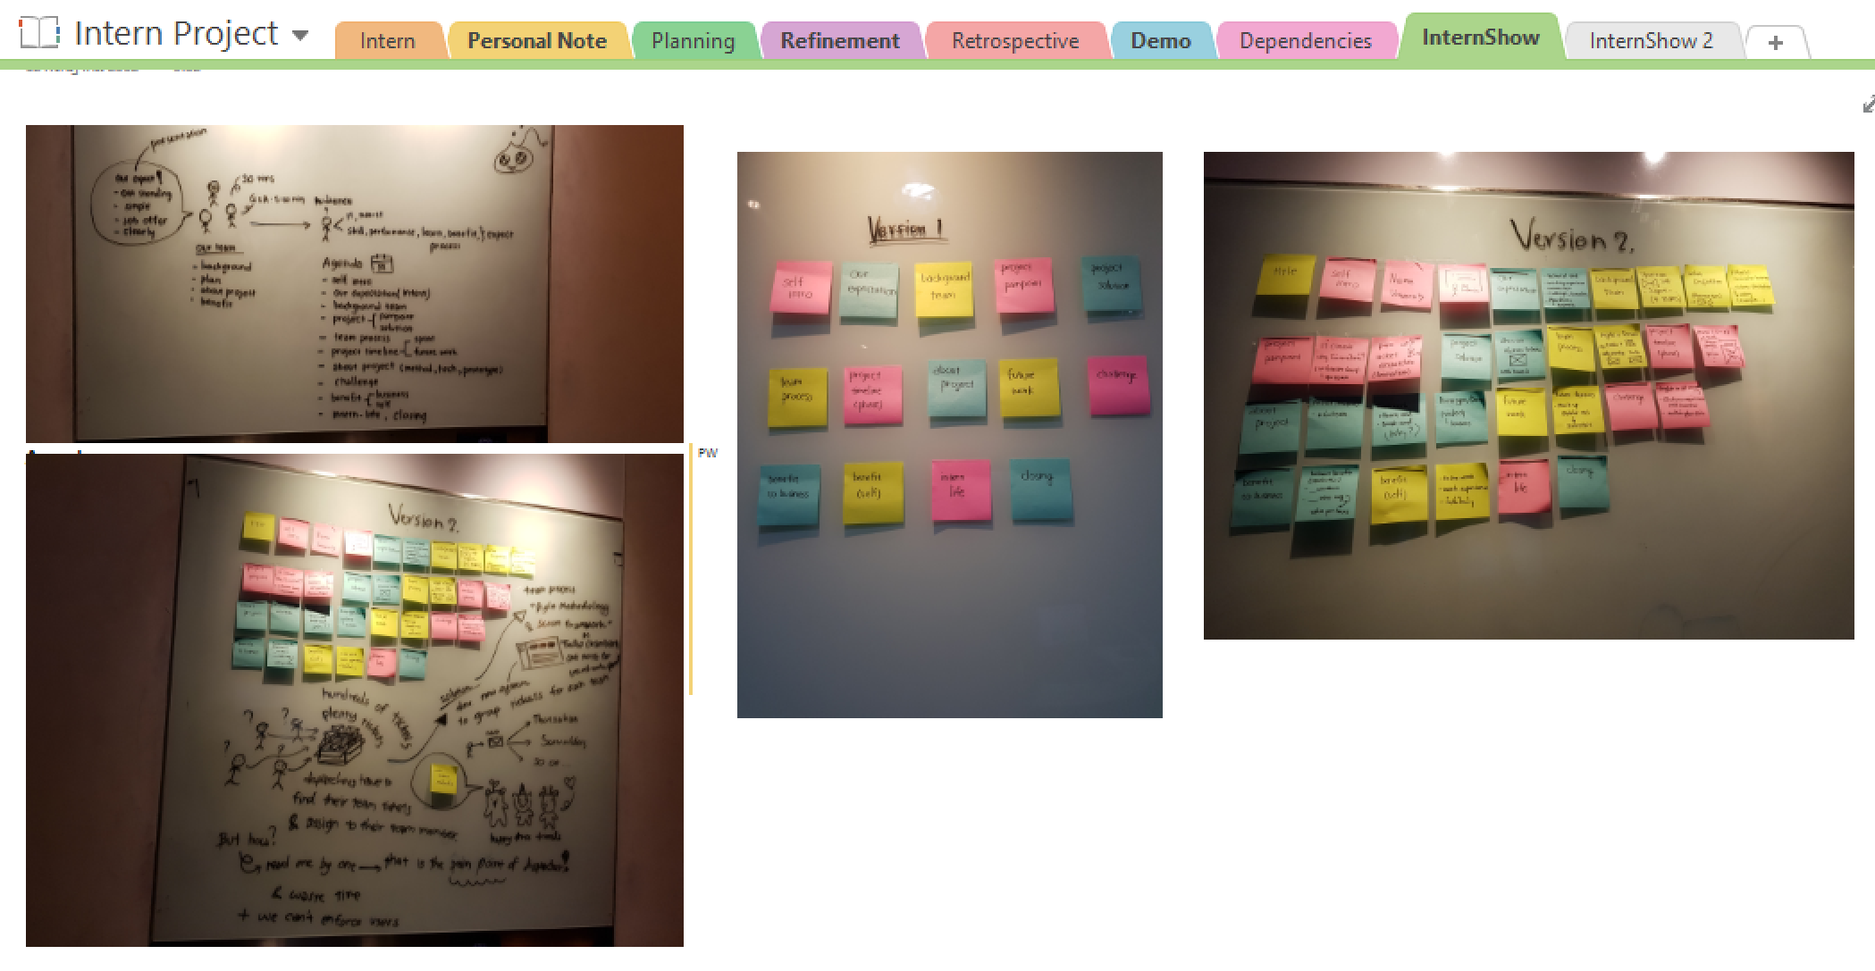

Slide 19
Timeline
Phase 1
Phase 2
2months
4months

Slide 20
Phase 1 (2 months)
Sprint 1
Sprint 2
Sprint 3
Gather requirements
Learning development tools
Design wireframe and UI version 1
Design system overview version 1
Make website version 1
Rewrite some logics
Refactor code (optimize and clean code)
Prepare for Interns show presentation
Redesign UI (version 2)
Redesign system overview
Make website version 2
Use version control (GitLab)

Slide 21
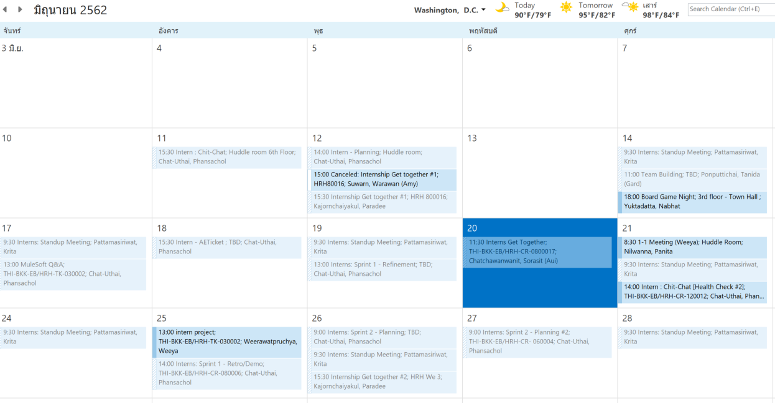

Slide 22
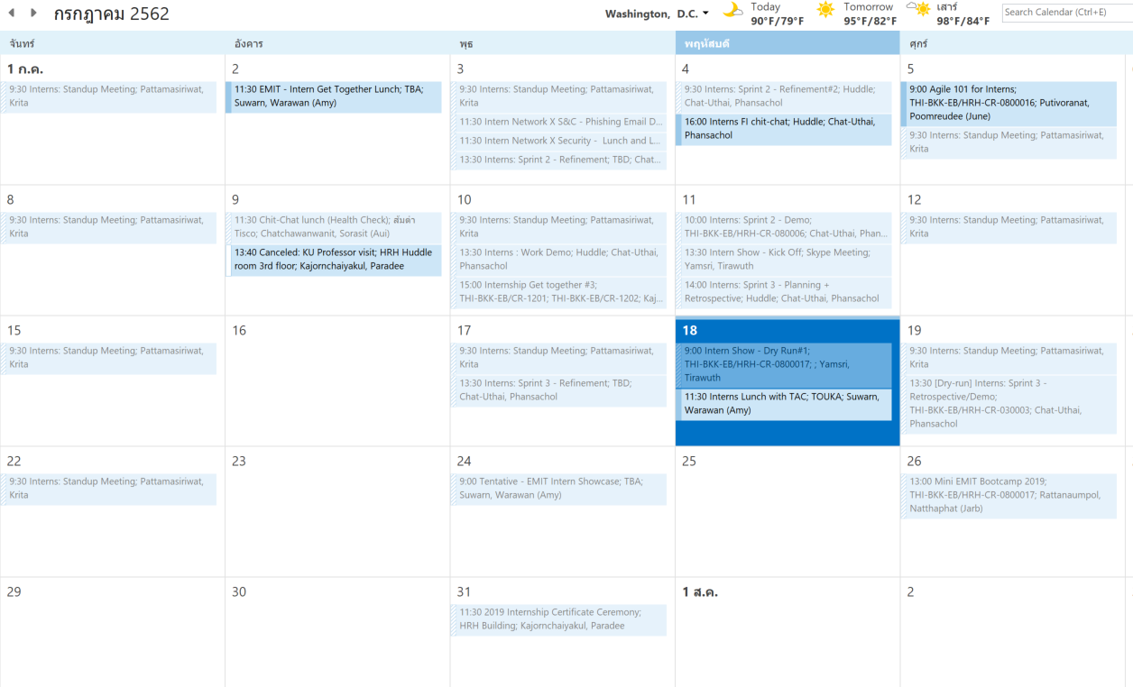

Slide 23
What we do?

Slide 24
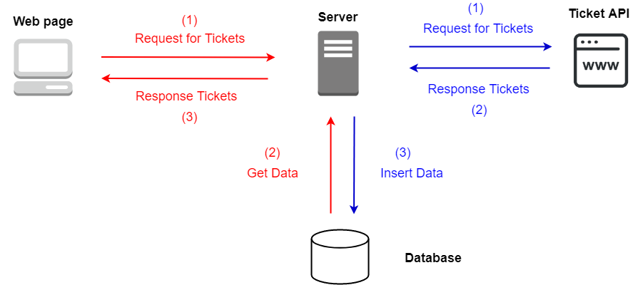
System overview

Slide 25


Technologies – Front End
React

Slide 26



Technologies – Backend
Python

Slide 27
demo

Slide 28
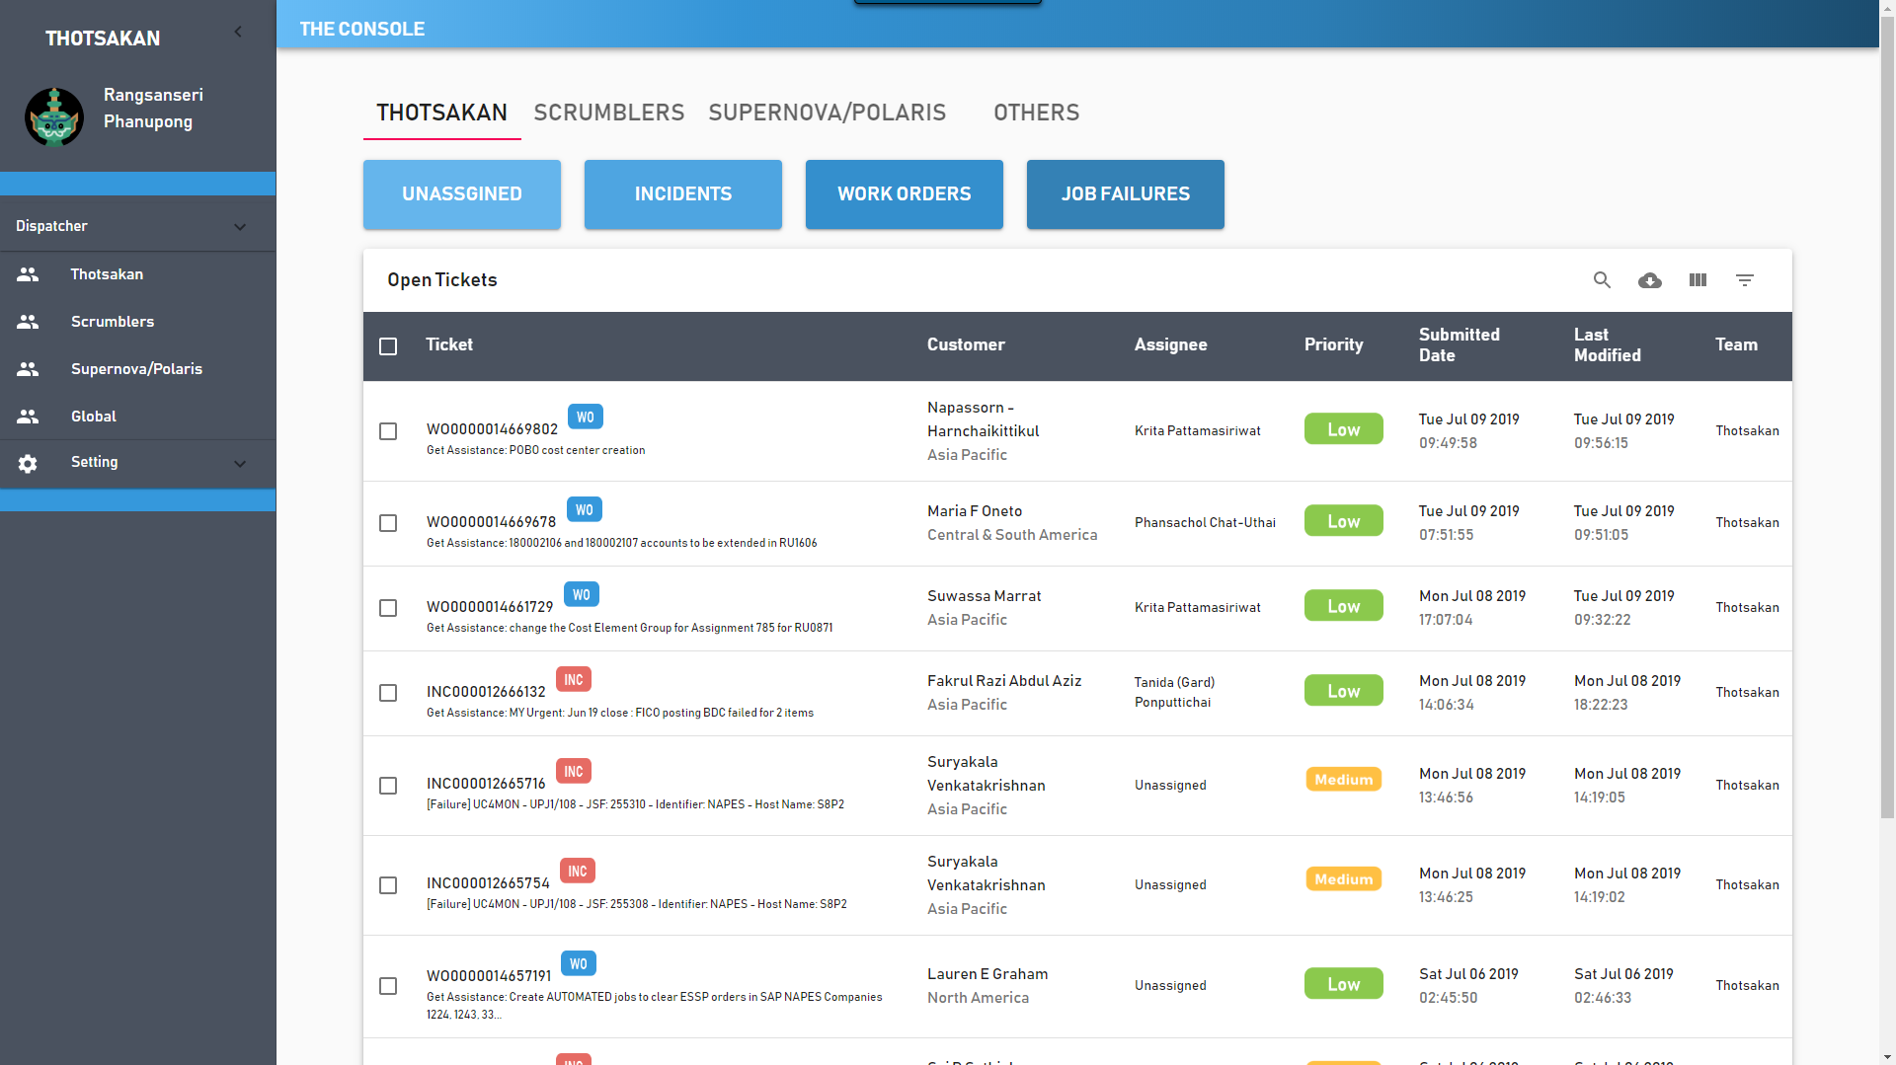
Home page

Slide 29
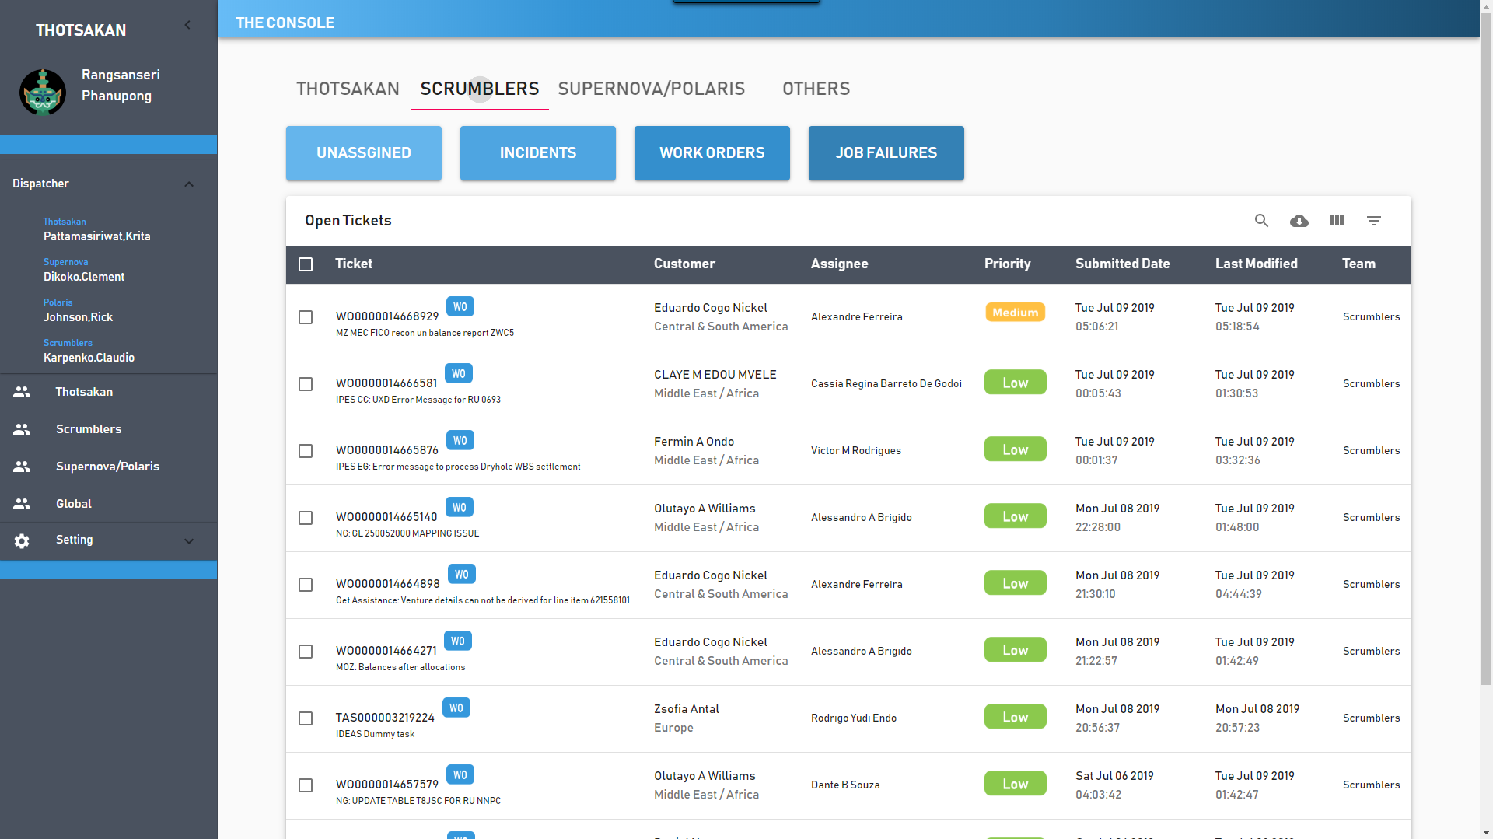
Team classification

Slide 30
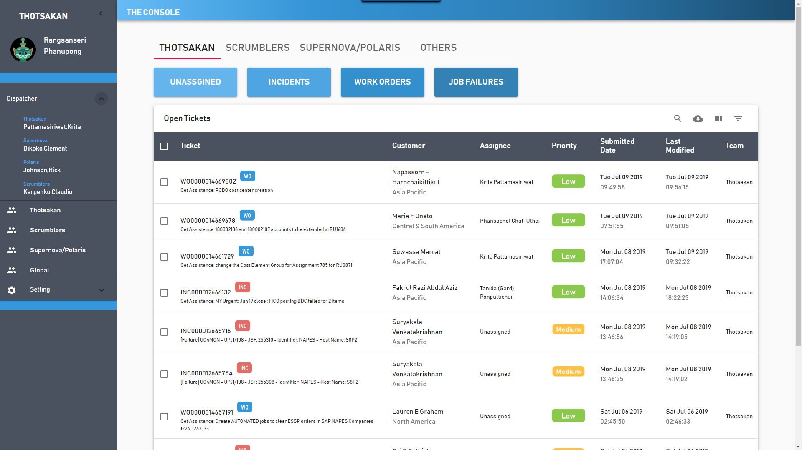
Display dispatcher

Slide 31
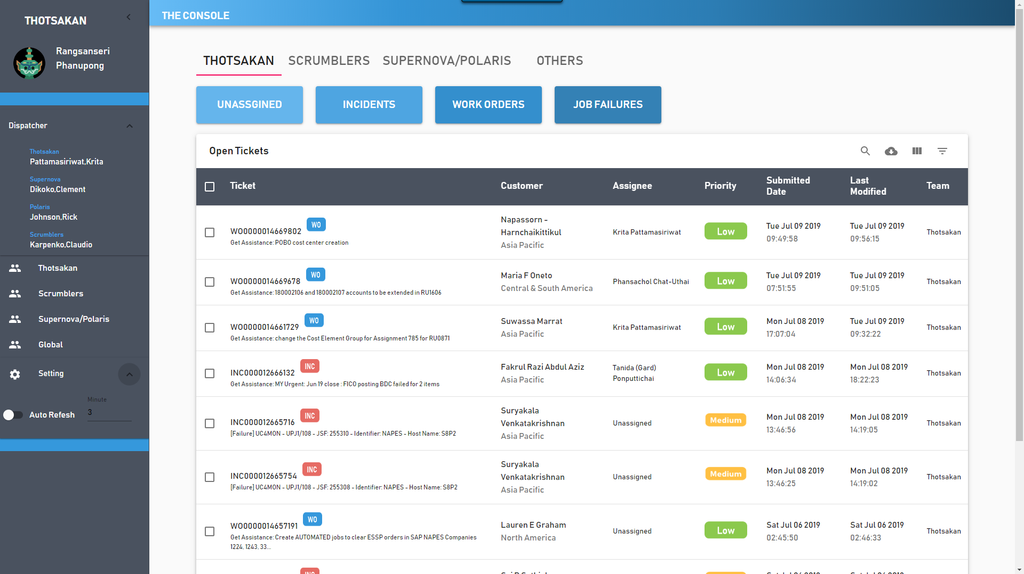
Auto refresh

Slide 32
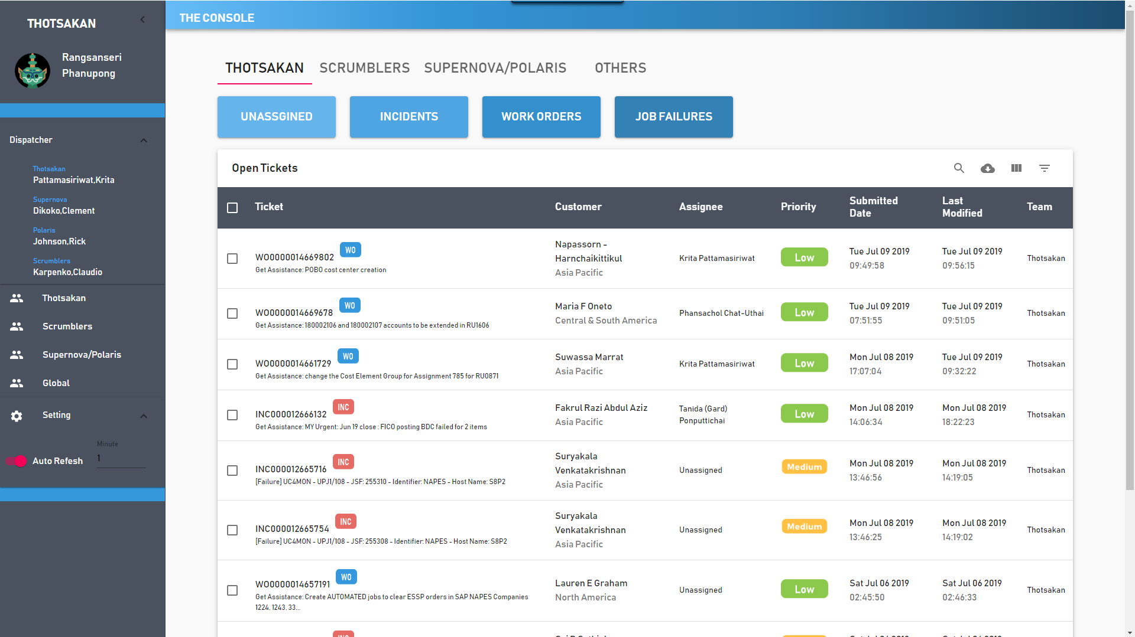
Auto refresh

Slide 33
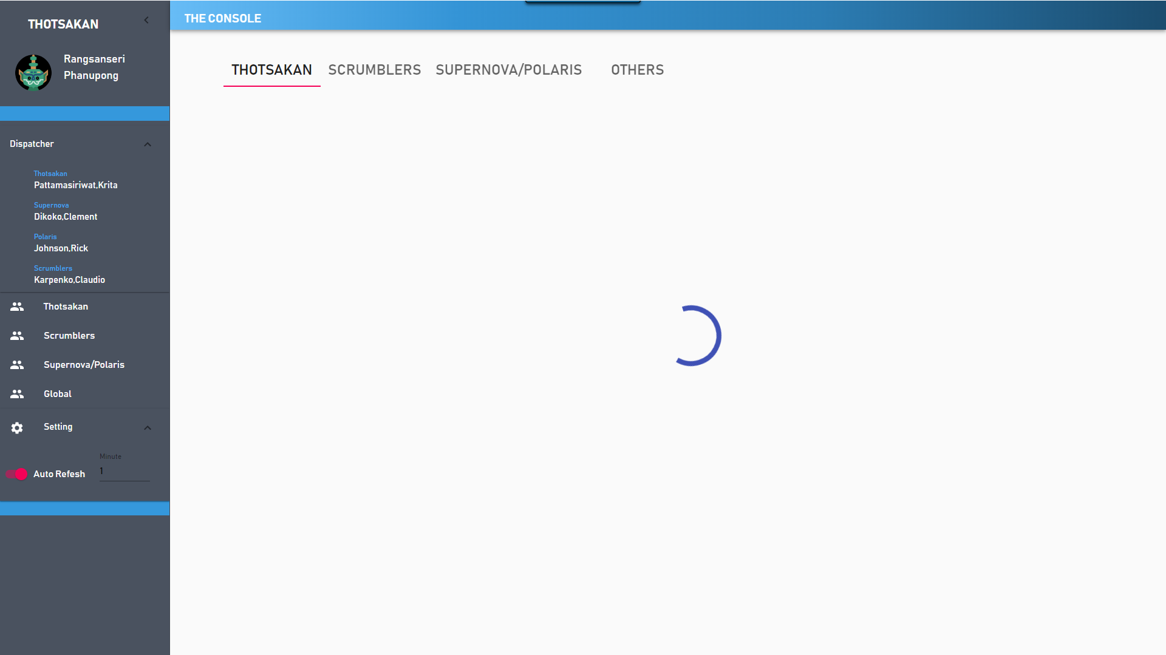
Auto refresh

Slide 34
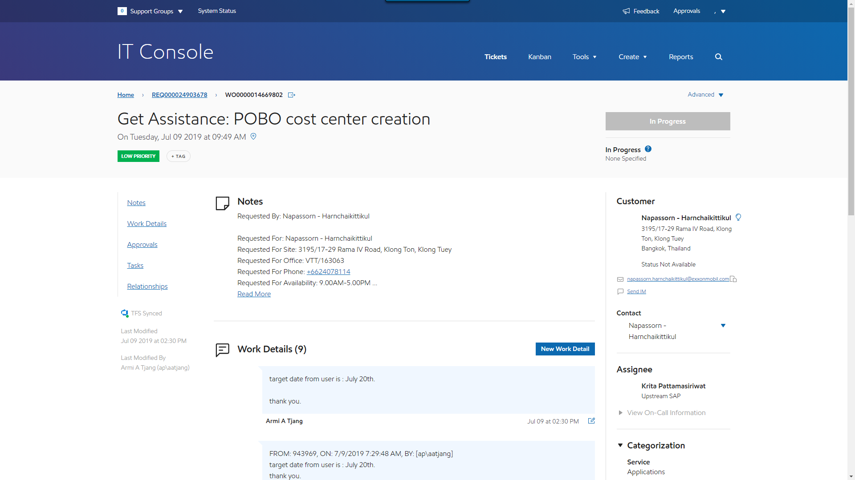
Ticket detail

Slide 35
Future work
Phase 2 (4 months)
Notification
Statistics page
ITSM’s ticket info update
Notes:
Statistics and deploy

Slide 36
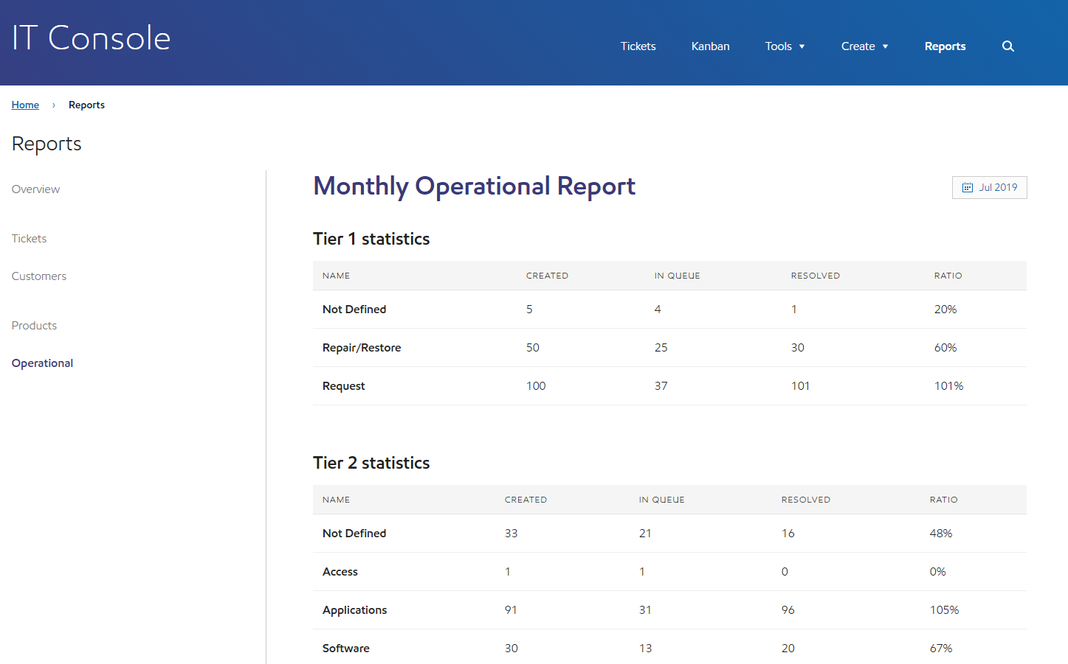
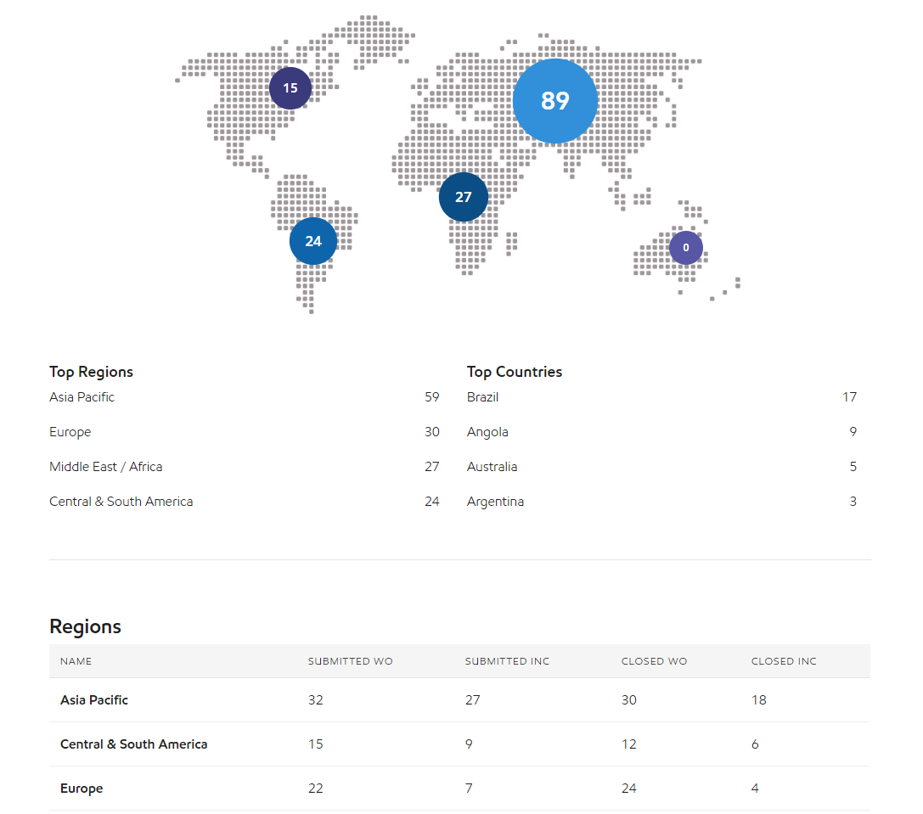
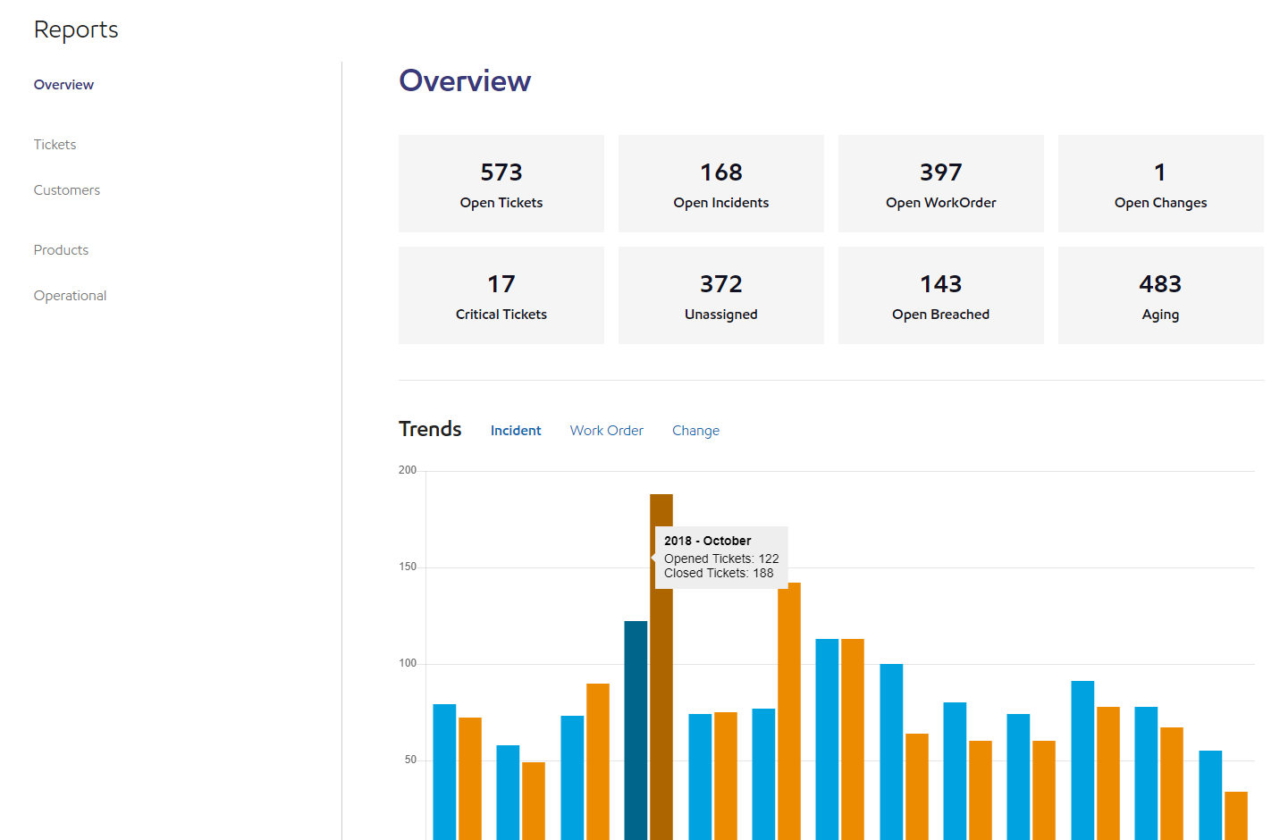
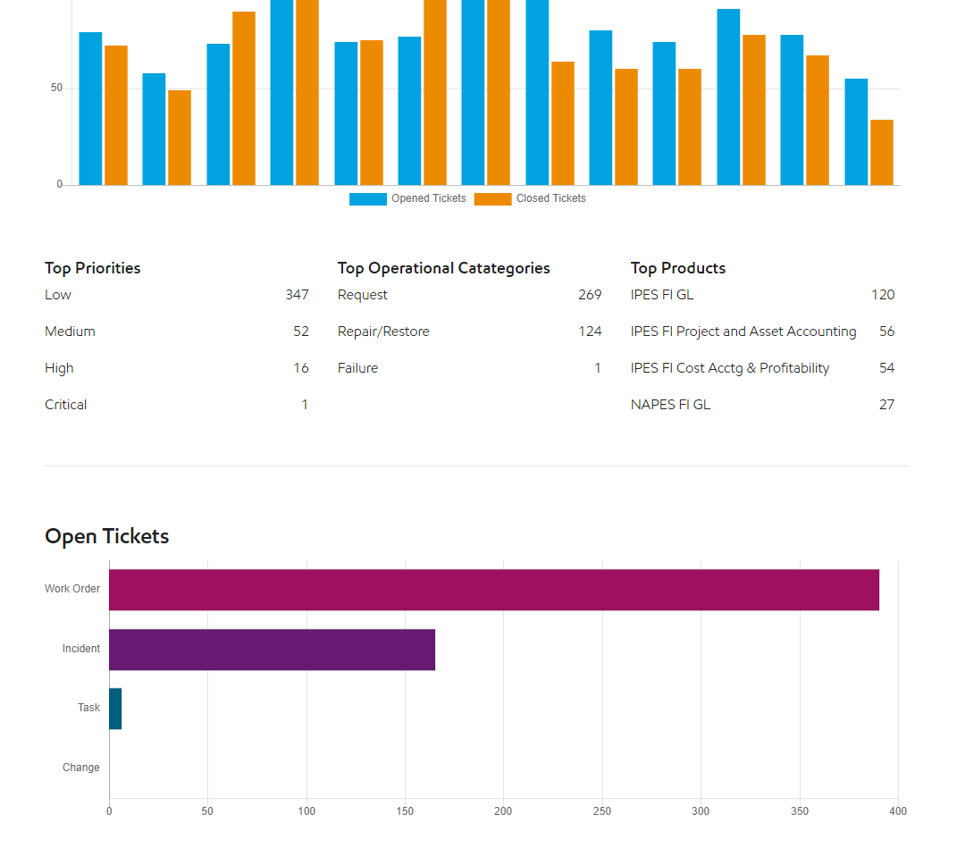

Slide 37
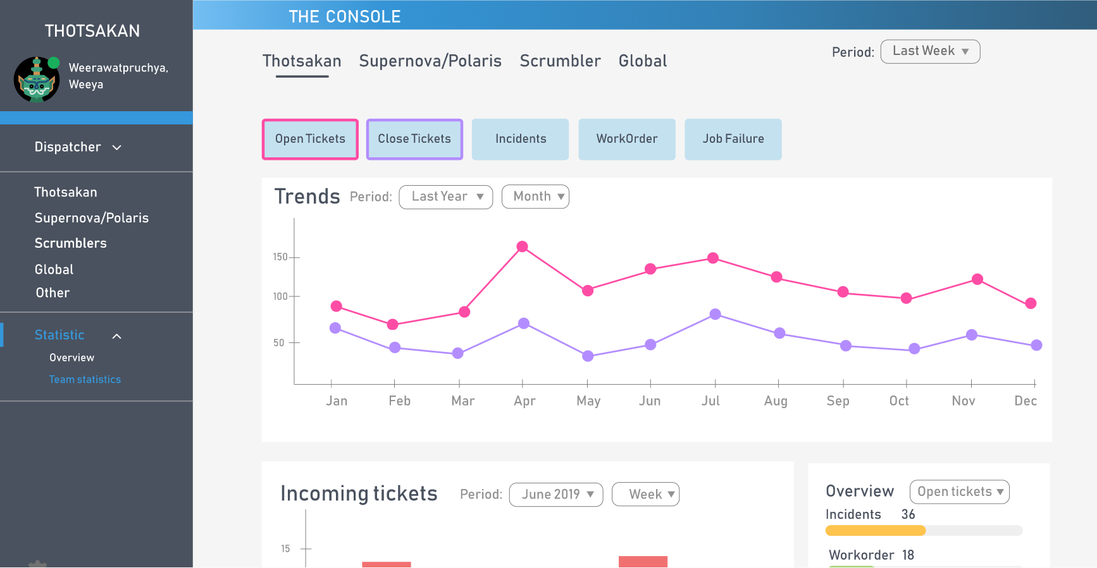
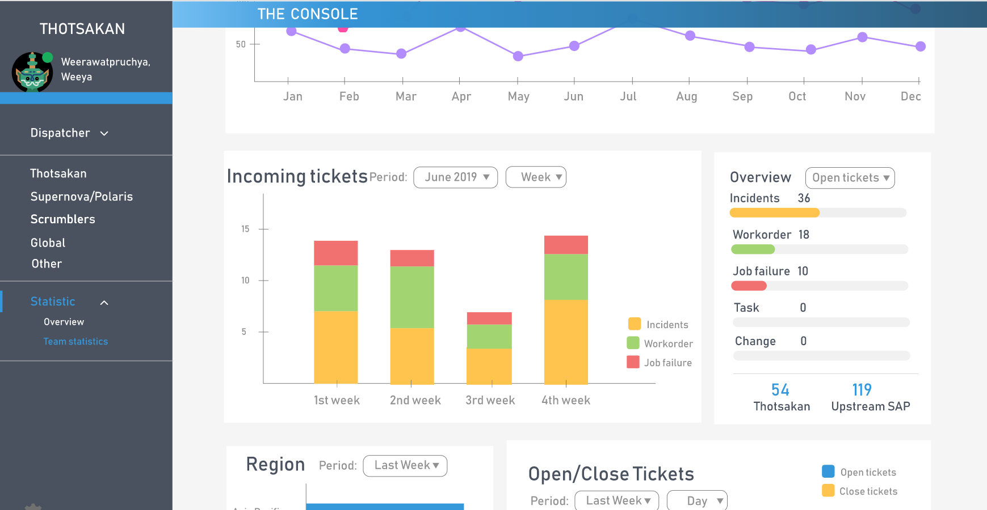
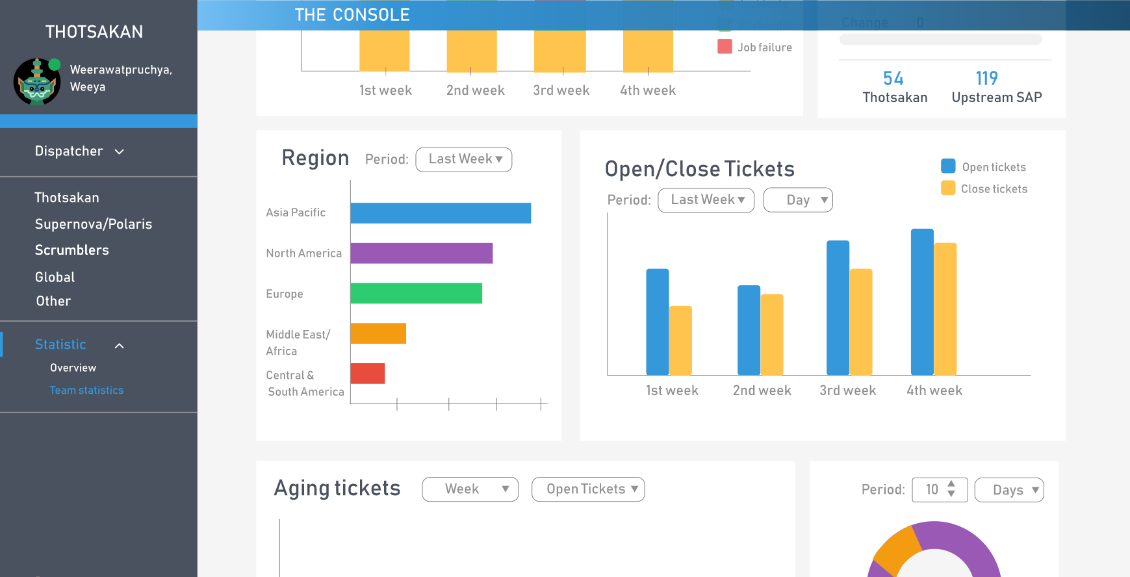
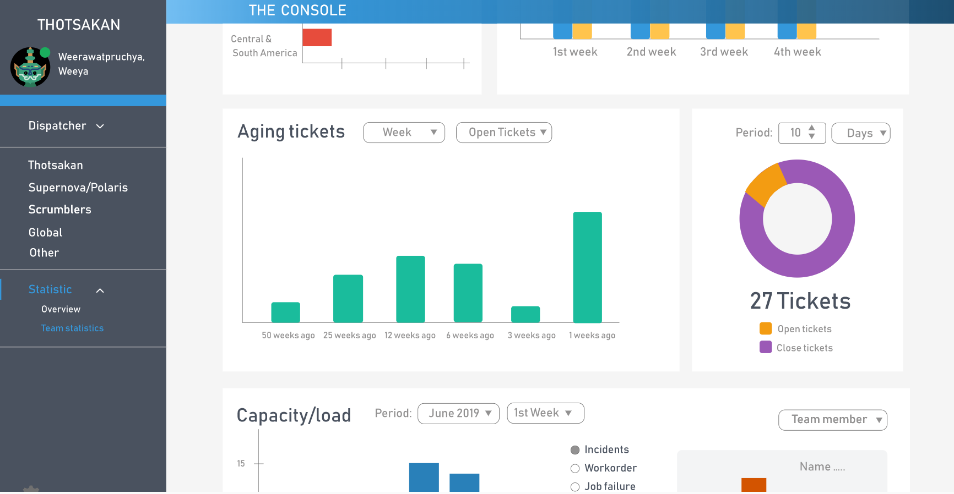

Slide 38


Benefit to team
Reduce times usage
Improve efficiency

Slide 39


Challenge
Collaborations with new friends
Adapt to project's requirement changing
Time limitation
Speak English

Slide 40
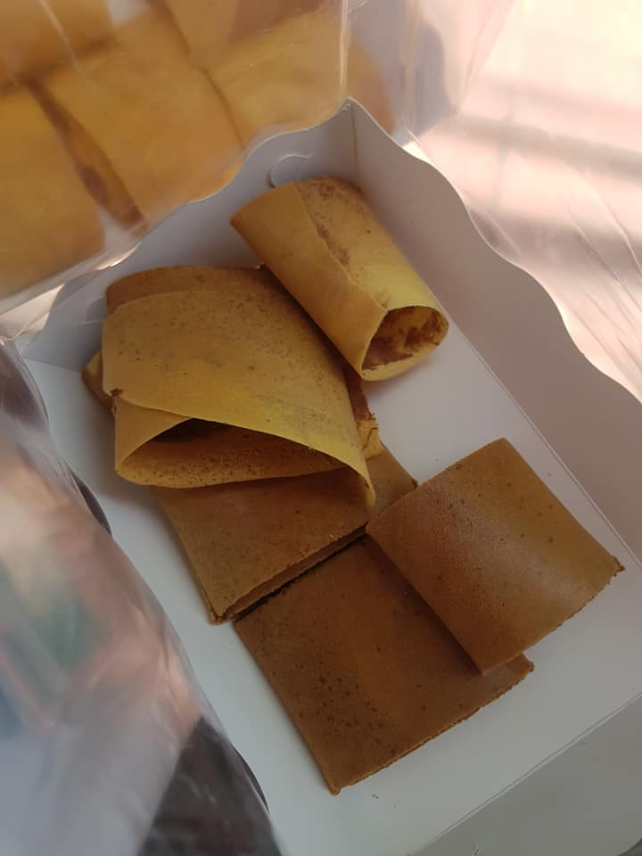
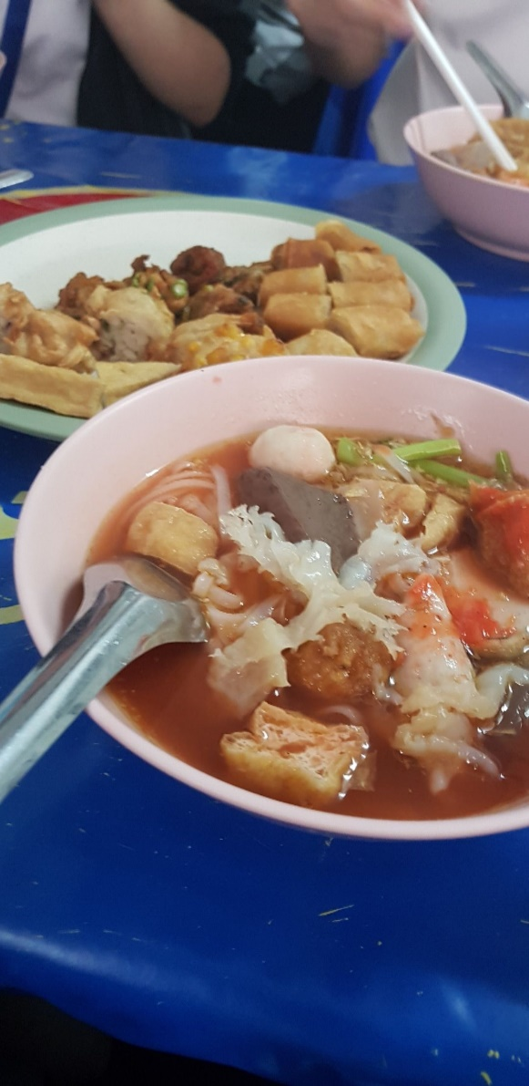


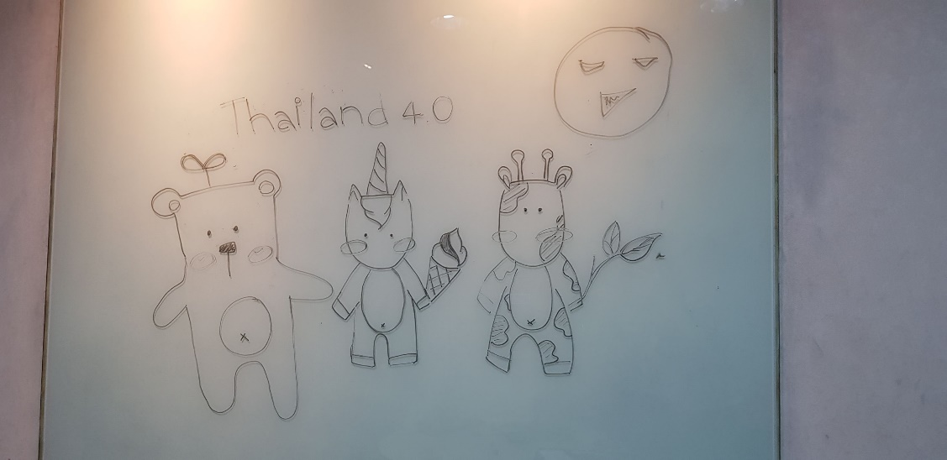
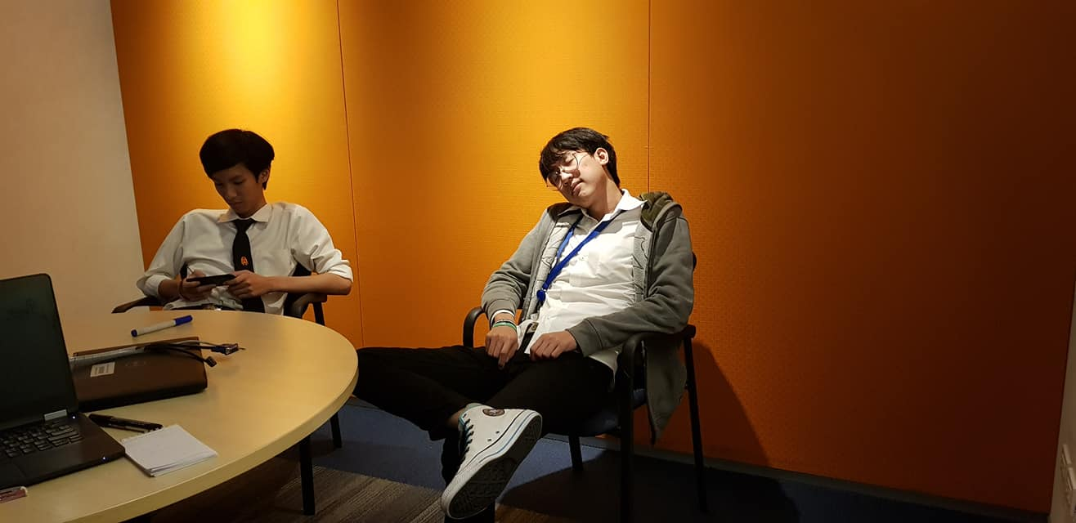

Slide 41
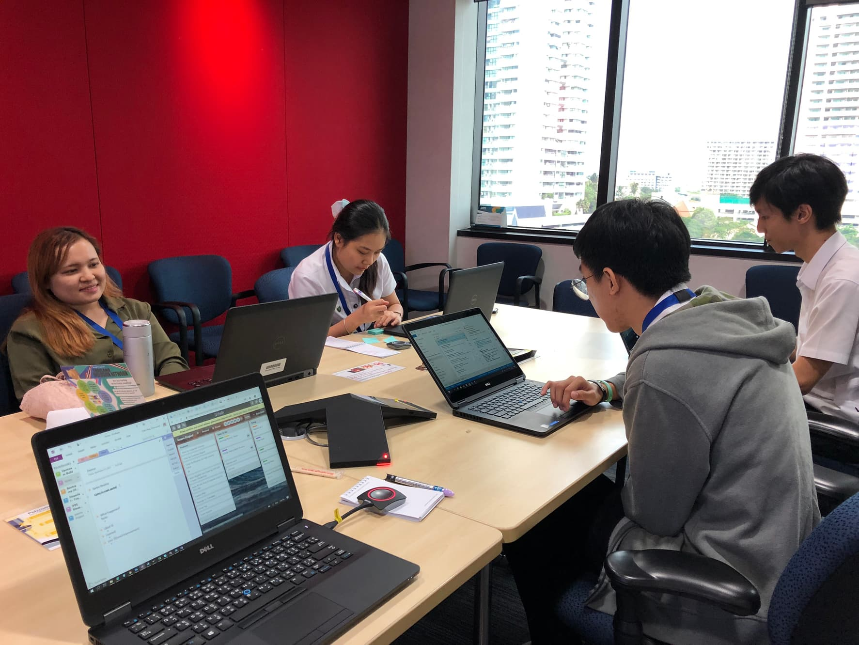

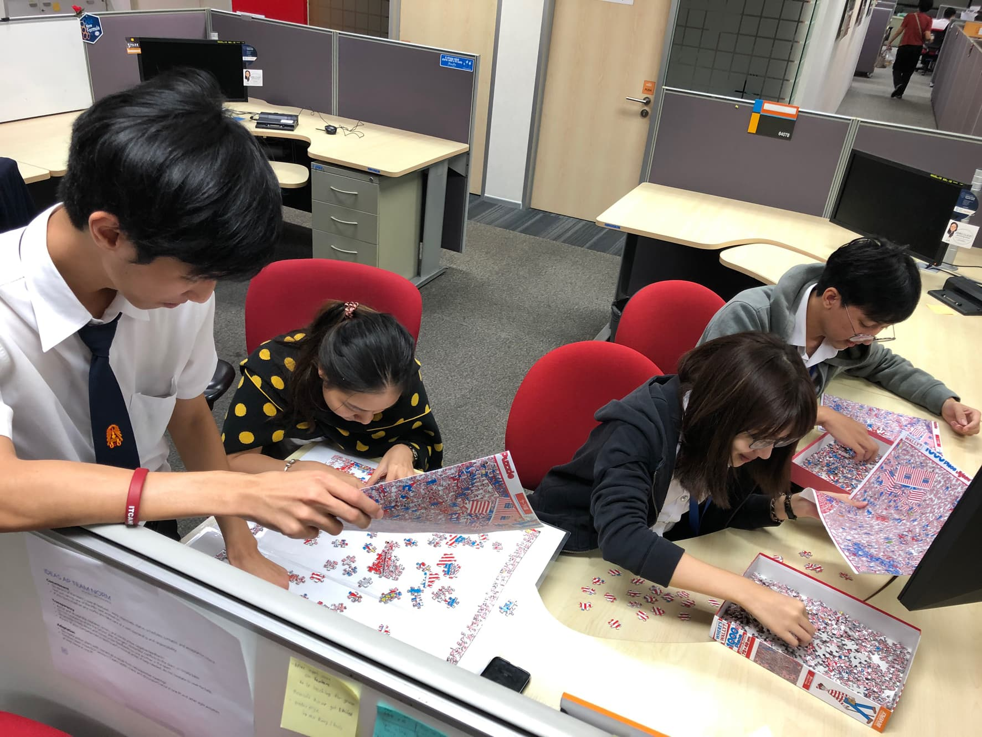
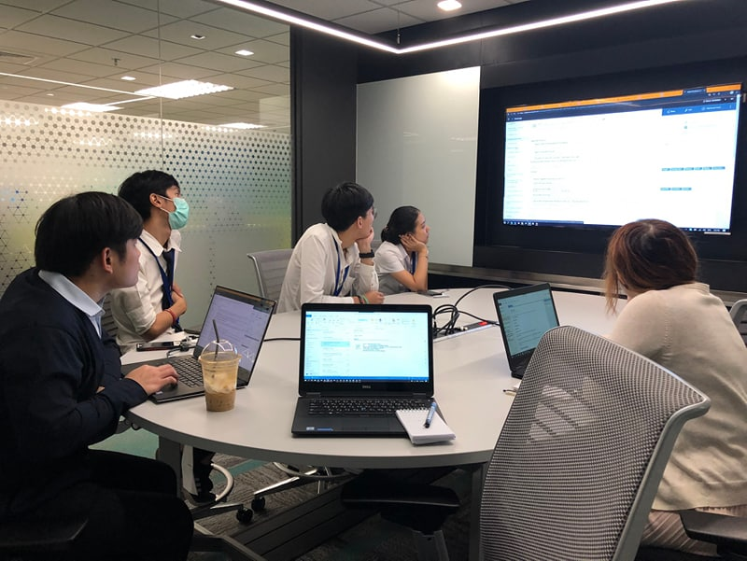
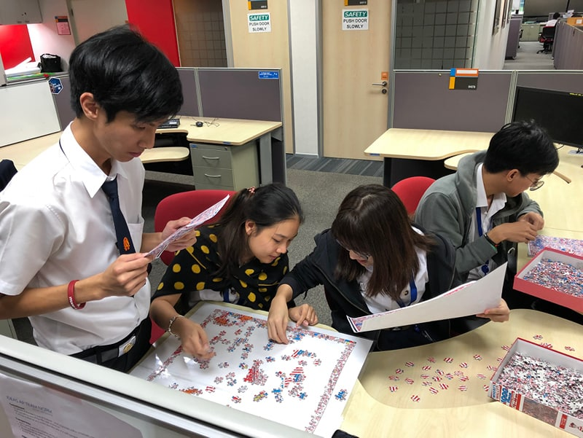
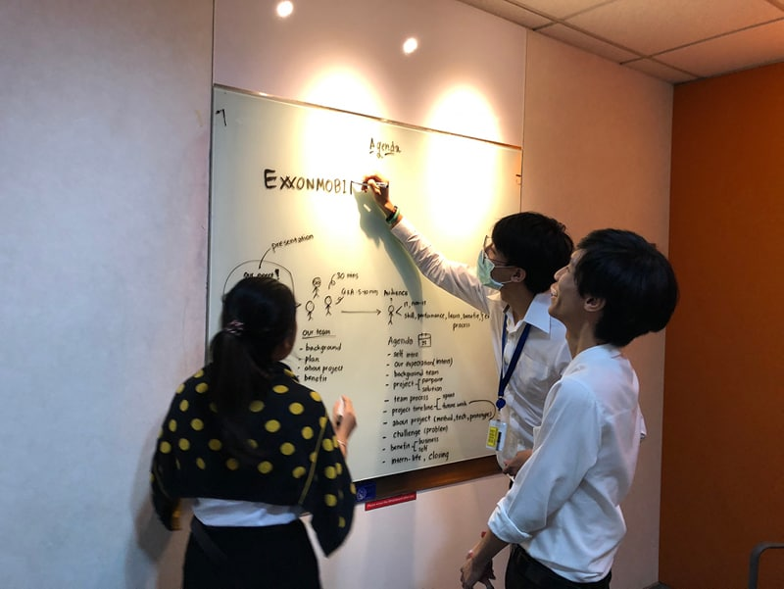

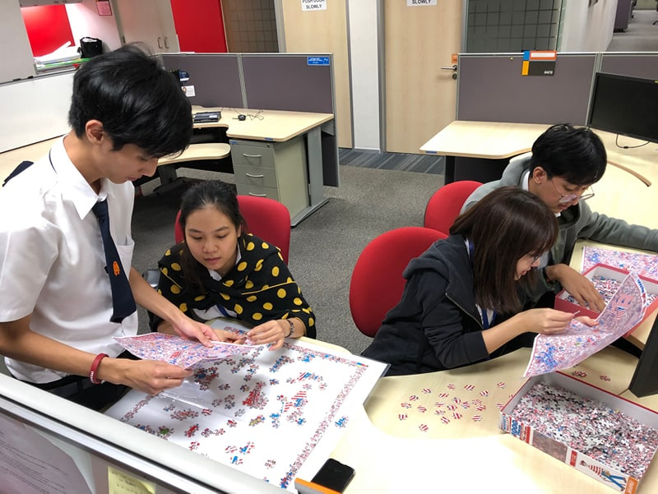

Slide 42
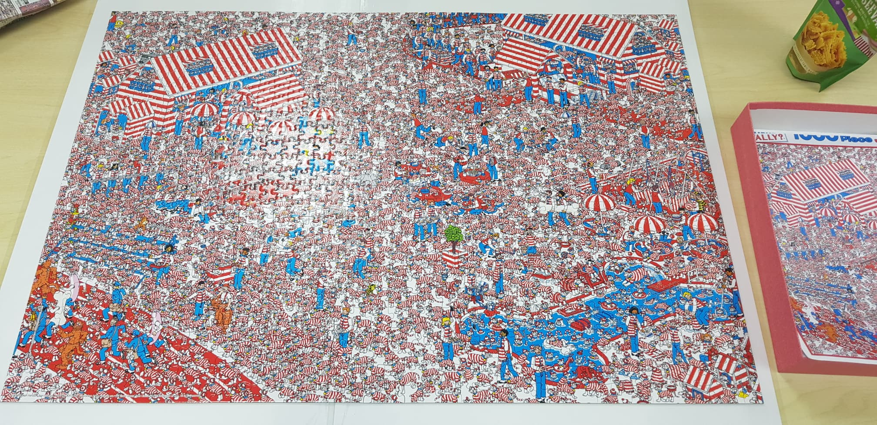
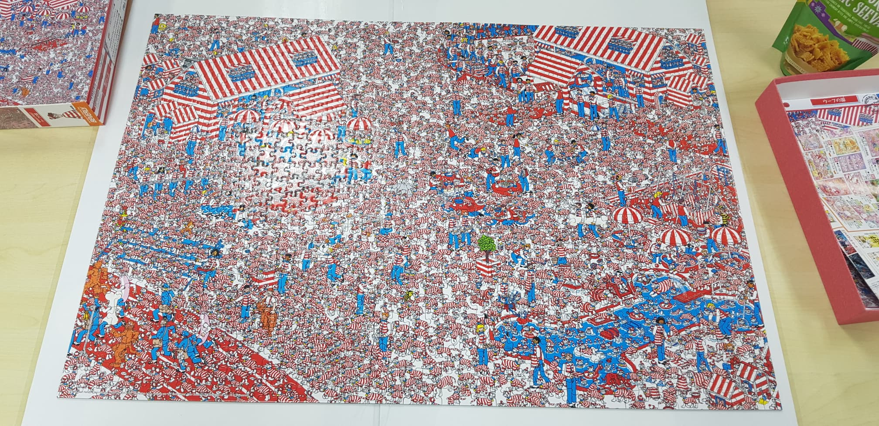

Slide 43
If you only do what you can do,
You’ll NEVER BE BETTER
Than what you are.
-Master Shifu-

Slide 44
Q & A

